Slide 1
Activities involved in Software Requirement Analysis

Slide 2
Why?
Why should you document the system requirements? As a rule, you already have customer requirements, so why invest time and effort to document additional system requirements?
In a project, you want to deliver the agreed results on time, within budget, and in the quality required by the customer. If you do not document your system requirements, you may overlook the functionality or completely misinterpret your customers' expectations. This causes additional effort, costs and delays. You can also overlook aspects of your system that are essential to the functionality or non-functional aspects of your system. This can lead to false starts or even additional development cycles.

Slide 3
Software requirement
Software requirement means requirement that is needed by software to increase quality of software product. These requirements are generally a type of expectation of user from software product that is important and need to be fulfilled by software. Analysis means to examine something in an organized and specific manner to know complete details about it.

Slide 4
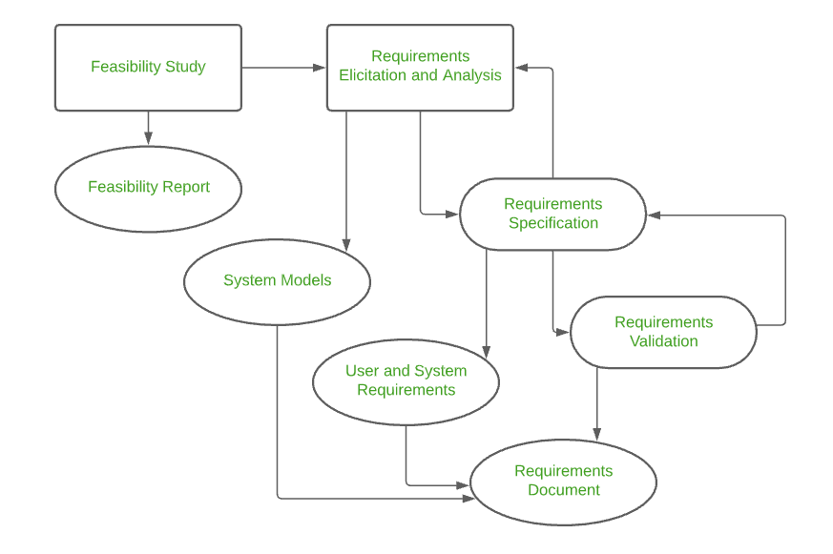
Requirements Engineering Process

Slide 5
Inception
This is the first phase of the requirements analysis process. This phase gives an outline of how to get started on a project. In the inception phase, all the basic questions are asked on how to go about a task or the steps required to accomplish a task. A basic understanding of the problem is gained, and the nature of the solution is addressed. Effective communication is very important in this stage, as this phase is the foundation as to what must be done further. Overall, in the inception phase, the following criteria must be addressed by the software engineers:
Understanding of the problem.
The people who want a solution.
Nature of the solution.
Communication and collaboration between the customer and developer.

Slide 6
Elicitation
This is the second phase of the requirements analysis process. This phase focuses on gathering the requirements from the stakeholders. One should be careful in this phase, as the requirements are what establishes the key purpose of a project. Understanding the kind of requirements needed from the customer is very crucial for a developer. In this process, mistakes can happen in regard to, not implementing the right requirements or forgetting a part. The right people must be involved in this phase.

Slide 7
The following problems can occur in the elicitation phase:
Problem of Scope: The requirements given are of unnecessary detail, ill-defined, or not possible to implement.
Problem of Understanding: Not having a clear-cut understanding between the developer and customer when putting out the requirements needed. Sometimes the customer might not know what they want, or the developer might misunderstand one requirement for another.
Problem of Volatility: Requirements changing over time can cause difficulty in leading a project. It can lead to loss and wastage of resources and time.

Slide 8
Elaboration
This is the third phase of the requirements analysis process. This phase is the result of the inception and elicitation phase. In the elaboration process, it takes the requirements that have been stated and gathered in the first two phases and refines them. Expansion and looking into it further are done as well. The main task in this phase is to indulge in modeling activities and develop a prototype that elaborates on the features and constraints using the necessary tools and functions.

Slide 9
Here are some tasks are given that is important in the evaluation and synthesis of software requirement :
To define all functions of software that necessary.
To define all data objects that are present externally and are easily observable.
To evaluate that flow of data is worth or not.
To fully understand overall behavior of system that means overall working of system.
To identify and discover constraints that are designed.
To define and establish character of system interface to fully understand how system interacts with two or more components or with one another.

Slide 10
Negotiation
This is the fourth phase of the requirements analysis process. This phase emphasizes discussion and exchanging conversation on what is needed and what is to be eliminated. In the negotiation phase, negotiation is between the developer and the customer, and they dwell on how to go about the project with limited business resources. Customers are asked to prioritize the requirements and make guesstimates on the conflicts that may arise along with it. Risks of all the requirements are taken into consideration and negotiated in a way where the customer and developer are both satisfied with reference to the further implementation.

Slide 11
The following are discussed in the negotiation phase:
Availability of Resources.
Delivery Time.
Scope of requirements.
Project Cost.
Estimations on development.

Slide 12
Specification:
Written document.
A set of models.
A collection of use cases.
A prototype.
This is the fifth phase of the requirements analysis process. This phase specifies the following:

Slide 13
Validation
All the requirements have been stated and met correctly
Errors have been debugged and corrected.
Work product is built according to the standards.
This is the sixth phase of the requirements analysis process. This phase focuses on checking for errors and debugging. In the validation phase, the developer scans the specification document and checks for the following:

Slide 14
This requirements validation mechanism is known as the formal technical review. The review team that works together and validates the requirements include software engineers, customers, users, and other stakeholders. Everyone in this team takes part in checking the specification by examining for any errors, missing information, or anything that must be added or checking for any unrealistic and problematic errors. Some of the validation techniques are the following-
Requirements reviews/inspections.
Prototyping.
Test-case generation.
Automated consistency analysis.

Slide 15
Requirements Management
This is the last phase of the requirements analysis process. Requirements management is a set of activities where the entire team takes part in identifying, controlling, tracking, and establishing the requirements for the successful and smooth implementation of the project. In this phase, the team is responsible for managing any changes that may occur during the project. New requirements emerge, and it is in this phase, responsibility should be taken to manage and prioritize as to where its position is in the project and how this new change will affect the overall system, and how to address and deal with the change. Based on this phase, the working model will be analyzed carefully and ready to be delivered to the customer.

Slide 16
Small exercise
Suppose that you need to develop a URL shortening service. What requirements you need to consider before starting the development?

Slide 17
Functional Requirements | Nonfunctional Requirements
Given a long URL create a short URL | Very low latency
Given a short URL redirect to a long URL | Very high availability

Slide 18
Key question: How long should the url be?
Need to know the scale of the operation?
Example: 1000 URLs generated each second
1000 * 60 * 60 * 24 * 365 = 31.5 billion URLs each year
10 to 1 read to write requests mean 300 billion reads per year
Unique short URLs
What characters can we use?
a-z 26
A-Z 26
0-9 10
62^1 = 62
62^2 = 3814
62^6 = 56 billion
62^7 = 3.5 trillion

Slide 19
Storage
Assuming lifetime of service to be 100 years and with 2.6 billion shortened links creation per month, total number of data points/objects in system will be = 2.6 billion/month * 100 (years) * 12 (months) = 3120 billion
Assuming size of each data object (Short url, long url, created date etc.) to be 500 bytes long, then total require storage = 3120 billion * 500 bytes = 1419 TB

Slide 20
Memory
Following Pareto Principle, better known as the 80:20 rule for caching. (80% requests are for 20% data)
822 million reads per day
To cache 20% of these requests, we will need ~ 82.2 GB of memory.
0.2 * 822 million * 500 bytes = ~ 82.2 GB

Slide 21
Additional Considerations:
Target Users: Identify the target audience for this program. Are they individual users, businesses, or a combination?
Integration: Consider if the program needs to integrate with other services, such as link tracking or analytics tools.
Reporting: The program may offer basic reporting features, such as the number of shortened URLs generated and the number of clicks on each shortened URL (optional).

Slide 22
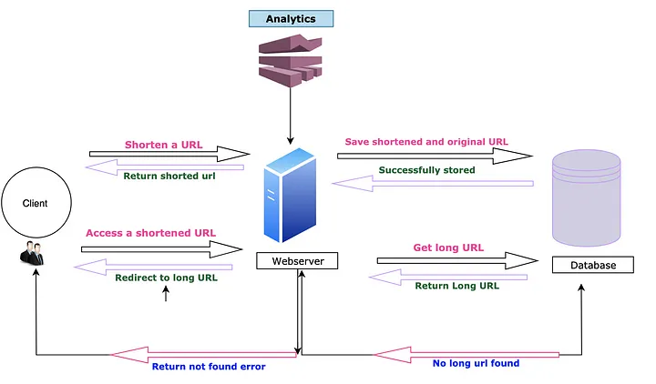

Slide 23
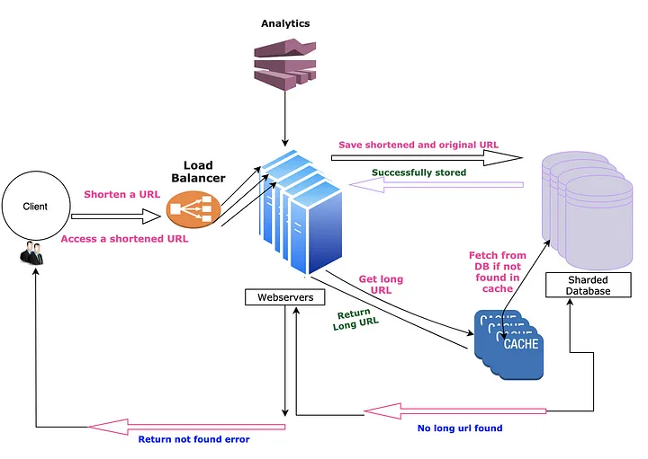

Slide 24
THANK YOU

